Slide 1


Azure Resource Manager
Inside-Out
Kristian Nese
Senior Program Manager
OMS CAT

Slide 2

Personas
Service Admin
Will be the service administrator that manage the Azure/Azure Stack subscription(s)
Notes:
During this course, we will mainly deal with the following personas to demonstrate the service provider scenarios and also how tenants are interacting with their services.
The Service Admin represents the IT-pro/DevOp working for the Cloud Service Provider, and is the person who does the design, architecture and instantiates the solutions in Azure.
The Tenant is the customer who subscribes to resources through the subscription.
During demos, look for the persona icon in the upper right, to see whether the actions are performed by the service admin or the tenant

Slide 3
The following persona(s) will be used throughout this module:
Service Admin
Notes:
During this module <module name> (technical foundation – Azure Resource Manager) we will use the following persona(s):
Service Admin.
As this is a foundation session focusing on ARM in general and the objective is to get the participants familiar with its concepts and capabilities, tenant scenarios are out of scope.

Slide 4

Insider Tip: Topic
When you see these slides, you should pay attention as this is where we will share our best practices from the field
These topics are also great discussions points

Slide 5
What to Expect?
Over the course of this technical foundation, we will be covering the overview of Azure Resource Manager, such as templates, deployment, operations and capabilities, as well as architecture and decisions you must take.
This will cover each of the core concepts, functional areas and scenarios
This technical foundation will help you to get a solid understanding of ARM and ensure you are ready to proceed with the scenario based modules that will leverage what you will learn here.
Notes:
This is one of the technical foundation sessions in the program, and the goal here is to give the audience enough information and knowledge around Azure Resource Manager, it’s interfaces (we will mainly be focusing on Portal, PowerShell and GitHub) and how they should prepare their environment.
Once they have successfully completed this session and the related labs, they should be able to proceed into the more specific use case scenarios with ARM.
This session is a “general” session and will only be relevant for the service admins (not the tenant/customer).

Slide 6
Azure Resource Manager
This module gives you an introduction to Azure Resource Manager API
This is a highly interactive workshop that:
Provides guidance and reference on the key topics
Talk about the scenarios and technical decisions you will face during these tasks
Provide a walkthrough of the capabilities of Azure Resource Manager
Understand the possibilities, flexibility and power, as well as Microsoft’s approach to cloud management and orchestration
Notes:
Overview of what to expect from this module.
Explain that the focus is to give a broad overview of ARM in the context of authoring, deployment and control.
Encourage the audience to interact and be as active as possible in order to share experience and ask questions.
You should feel comfortable to address the questions during the presentation.

Slide 7
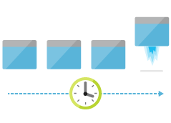
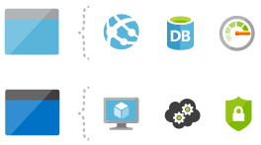
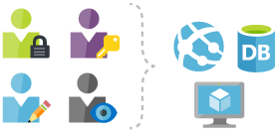
Agenda – Azure Resource Manager
Authoring
Deploy
Control
Notes:
The agenda for this technical foundation session is focusing on authoring, deployment and control.
But first thing first, a coverage of the ARM architecture and its capabilities so you get a complete overview of what Azure Resource Manager is all about
Authoring
We will cover the authoring experience of templates using both Portal and Visual Studio (graphical & code) and explain the common template language expressions.
Deploy
Deployment of resources into Azure is essential and can be performed using many different interfaces – but at the same time give a consistent experience.
Control
We will learn how to control our resources in Azure using TAGS and RBAC, so that a hosting service provider can ensure that service admins and tenants only have the access they need at any given time.
TAGS is also ideal to use in order to group and logically organize resource groups and its resources across Azure subscriptions.

Slide 8
Overview
Notes:
We will start with an overview to give you a comprehensive introduction to Azure Resource Manager and ensure that everyone is on the same page.
Azure Resource Manager is the solution that will eventually close the gap between public Azure and the newly announced Microsoft Azure Stack that will become available for customers on-premises datacenters. In a nutshell, you can think of ARM as the consistent API that let you “write once – deploy anywhere”.
ARM is the new API in Azure and for those of you who’s familiar with the Azure Service Management API (ASM), there’s some significant changes in ARM that we will need to introduce you for first.

Slide 9
Consistent Management Layer
Azure Resource Manager API
Notes:
You might have some preferences when it comes to how you would like to interact with your services in the cloud.
What’s good here is that Microsoft hasn’t excluded any specific interface, so you can choose between state-of-the-art PowerShell modules, x platform interfaces and even a GUI through the Azure Management Portal – if that’s what you prefer.
With Azure Resource Manager, we will have a consistent API and a consistent management layer.
In the following picture, you can see that the Azure Portal, the command line and also Visual Studio are consuming the ARM API – which again aggregates the underlying core – and service resource provider through the provider Rest points.
Azure CLI
For Mac, Linux and also Windows, you can use Azure CLI which provides a set of open source shell-based commands. The CLI is written in JavaScript and implemented using the Azure SDK for Node under the Apache 2.0 license.
The project repository is located at https://github.com/azure/azure-xplat-cli
Azure Resource Manager Rest API
You can manage your resources through ARM and its REST APIs directly.
We will cover the structure a bit more in detail later, but here is an example on how to create a new
Resource Group directly, using the REST API:
Azure Management Portal
The Azure Management Portal is accessible on https://portal.azure.com – and in the time of writing the portal is currently in a preview, although the ARM is GA.

Slide 10
Demo: Exploring the Interfaces for Microsoft Azure
Service Admin
Notes:
During this demo, the instructor will show the structure of the new portal.azure.com and also some of the cmdlets.

Slide 11
Management models for IaaS
Classic Model (v1)
Resource Manager (V2)
Cloud Service
Resource Group
Load Balancer w/ IP Address
Backend Pool (NICs)
VM w/ IP Address
Storage Account
VM
NIC
VM IP Address
VNet
Load Balancer
LB IP Address
Subnet
Disk (blob)
Reference
Reference
Reference
Storage Account
Virtual Network
DependsOn
Reference
Reference
Disk (blob)
Subnet-1
Network Security Group
Ongoing process…
V1 resources will
be migrated to V2
Notes:
IaaS v2 – Azure Resource Manager API replaces Service Management API
Compute, network and storage capabilities are all within Azure Resource Manager API and will fundamentally change – and simplify the design, deployment and management of your complex applications running in the Microsoft Clouds. One thing to point out is that Azure Resource Manager is JSON-based compared to the Service Management API which was based on XML.
With the new control plane in Azure Resource Manager, there are some conceptual changes that we need to cover before we proceed. This is important for you to know, especially if you are already very familiar with the previous Azure Management Portal and its Service Management API.
Availability Sets
Service Management API
In the previous portal with the service management APIs, it was recommended to create availability sets (with the same name) and associate with the virtual machines. The maximum of fault domains was 2.
Azure Resource Manager API
With ARM, availability sets are now a resource that is managed by the Microsoft.Compute resource provider. If you require HA for your VMs, they must be included in the availability set. The maximum fault domains in ARM is 3.
Cloud Service for Virtual Machines
Service Management API
Whenever you created a virtual machine through the service management API, it required a Cloud Service that served as a container for the virtual machine(s) and provided availability from the platform as well as load balancing.
Azure Resource Manager API
With ARM, we don’t have Cloud Service anymore as a required object for virtual machines.
Load Balancing
Service Management API
Load Balancing was provided as part of the creation of a Cloud Service, serving its virtual machines within this container.
Azure Resource Manager API
Through the Microsoft.Network resource provider, we now have Load Balancer as a resource type. The Load Balancer can be internal or external and the vNIC of the VM will be referencing the Load Balancer.
Affinity Groups
Service Management API
Whenever you wanted to create a virtual network, it also required an Affinity Group.
Azure Resource Manager API
Affinity Groups are no longer required, and to simplify, it doesn’t exist in the APIs exposed through ARM.
Virtual IP Address
Service Management API
The Virtual IP address (VIP) is associated with the implicit load balancer, and Cloud Services would get a default VIP once a VM was added to it.
Azure Resource Manager API
As with Load Balancers, a Public IP is a resource type exposed by the Microsoft.Network resource provider. A Public IP can be reserved or dynamic. The dynamic IPs can be assigned to a Load Balancer, and the IPs can be secured using Security Groups.
Reserved IP Address
Service Management API
An IP had to be associated with a Cloud Service in order to be reserved.
Azure Resource Manager API
Public IP addresses can be created in something called “static mode” which effectively is the same as a reserved IP. At the time of writing this, a static public IP can only be assigned to a Load Balancer.
DNS Name
Service Management API
During creation of a Cloud Service, an implicit globally unique name would be assigned, like “somecoffee.cloudapp.net”
Azure Resource Manager API
With ARM, the DNS names are optional parameters that can be specified on a Public IP address resource in this format: <domain>.<region>.cloudapp.azure.com
Network Interface
Service Management API
The Virtual Machine itself was the container for the primary and eventually - the secondary Network Interface.
Azure Resource Manager API
In ARM, a Network Interface is a resource that is exposed by the Microsoft.Network resource provider, and the lifecycle is no longer tied to a virtual machine.
Endpoints
Service Management API
Any Endpoints had to be configured at the VM level.
Azure Resource Manger API
Load Balancers can now be configured with Inbound NAT Rules.

Slide 12
What’s New About the v2 Resource Providers?
v1:
Not fully integrated: no RBAC, tagging, templates
Clunky network modelling
v2:
Fully integrated into Resource Manager
Revamped control plane with asynchronous, parallel operations
Network resource types are separate from compute
Part of Azure-consistent private cloud
Notes:
To summarize from the previous slide:
V1 is lacking support for RBAC, tagging and templates and is not the way forward.
However, please note that many customers has a lot of resources running in classic mode, that eventually need to be migrated to v2 at a later stage.
V2 resource providers are fully integrated to Azure Resource Manager and this is where all the effort is located from an engineering perspective in these days. ARM will handle the RPs as a control plane with async and parallel operations that will boost your deployment scenarios compared to classic mode.
As mentioned before, - V2 is a part of the Azure-consistent cloud vision, coming to On-prem with Azure Stack.

Slide 13
Deploying with Azure Resource Manager
template-driven
declarative
idempotent
multi-service
multi-region
extensible
Notes:
Everything you can deploy with ARM is template-driven. This means you can create a template and bootstrap your environments, applications and resources in the cloud. As you will see, we can also parameterize the templates and make it usable for others as well.
The template model itself is declarative and idempotent, which means you can define the exact state of your template and deploy it over and over again. This will ensure that the resources are in the correct state – and also simplify the update process of your resources by simply deploying the same template again only with different values. That means that if the resources are already created, they will be updated the way you have described in the template. If they aren’t created, the deployment process will create them.
Additionally, Azure Resource Manager is natively multi-service (both IaaS and PaaS) and multi-region.
Instead of creating individual resources and later stitch them together, we can create a template that deploys a virtual machine, storage, network resources and also application payload through VM extensions. Everything in a single operation that is executed in parallel.
Whenever you create a resource in Azure, it will be associated with a Resource Group – which is a logic container for all of its resources, such as virtual machines, networks and storage accounts. When you deploy a multi-node application to Azure using a template for Azure Resource Manager, these resources will belong to the same resource group. You can later add – or remove resources to the resource group and have quite a flexible way of doing life-cycle management.
Life-cycle management is key, and you are now able to structure this in your own whenever and wherever it makes sense.
An example of how you can use the concept of resource groups is when you deploy an application where all of its resources has a common life-cycle management. Another example is when you want to define management within your organization, and put all IaaS VMs running SQL server into the same resource group and grant the SQL SMEs access at the group level.

Slide 14
Resource Group
container for multiple resources
resources exist in one* resource group
resource groups can span regions
resource groups can span services
RESOU
R
CE G
R
OUP
*and only one
Notes:
Whenever you create a resource in Azure, it will be associated with a Resource Group – which is a logic container for all of its resources, such as virtual machines, networks and storage accounts. When you deploy a multi-node application to Azure using a template for Azure Resource Manager, these resources will belong to the same resource group. You can later add – or remove resources to the resource group and have quite a flexible way of doing life-cycle management.
Life-cycle management is key, and you are now able to structure this in your own whenever and wherever it makes sense.
With access we mean that Azure Resource Manager integrates natively with RBAC through the authorization core management resource provider, so that you can defined role based access for you and your team with the granular control you demand.
In addition, Azure Resource Manager supports tagging of resources and resource groups for simplified management, chargeback and billing purposes. Each resource supports up to 15 tags assigned.

Slide 15
Single or multiple resource groups?
Single Resource Group
Storage Account
Front End VMs
Virtual Network
Back End VMs
Multiple Resource Groups
RG1:
Storage Account
RG3: Front End VMs
RG2: Virtual Network
RG4: Back End VMs
Notes:
An example of how you can use the concept of resource groups is when you deploy an application where all of its resources has a common life-cycle management. Another example is when you want to define management within your organization, and put all IaaS VMs running SQL server into the same resource group and grant the SQL SMEs access at the group level.

Slide 16
Insider Tips: Resource Group Best Practices
Plan your Resource Group design carefully
Not all resources can be moved between Resource Groups at this time
Know that the Resource Group’s location is where the metadata is located
Know your subscription limitations – as this can impact how you design your Resource Groups
Get-AzureRmVMUsage and Get-AzureRmStorageUsage can be helpful during planning

Slide 17
imperative or declarative
$vNET = New-AzureRmVirtualNetwork -Name $vNetName -ResourceGroupName $RGname -Location $Location -AddressPrefix $vNetAddressPrefix -Subnet $SubnetConfig
$StorageAccount = New-AzureRmStorageAccount -ResourceGroupName $RGname -Name knstor5050 -Type $StorageType -Location $Location
New-AzureRmVM -ResourceGroupName $RGname -Location $Location -VM $VirtualMachine
{
"$schema": "https://../deploymentTemplate.json#",
"contentVersion": "1.0.0.0",
"parameters": {},
"variables": {},
"resources": [],
"outputs": {}
}
You decide
Notes:
Azure Service Management API (v1) did only support the “imperative” way of deploying resources, which very often lead to complex PS scripts, ideally with a lot of error handling.
With Azure Resource Manager (V2), you can use both. The slide shows the new AzureRM module on how to deploy storage account, vNet and a virtual machine using those resources. This is the imperative way of doing deployment with ARM.
For declarative, JSON is used with an Azure Resource Manager template as described earlier.
Key takeaway is that ARM supports both.

Slide 18
Authoring
Notes:
We have covered the high-level basics of ARM and it’s capabilities so far, and we will now start to investigate the authoring experience.
In order to go ahead with authoring, we need to know about the opportunities we have and learn more about the JSON syntax.

Slide 19
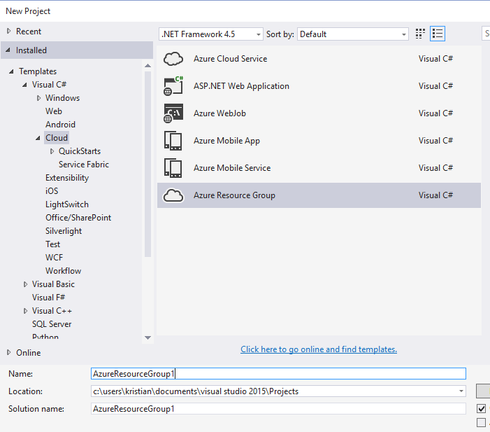
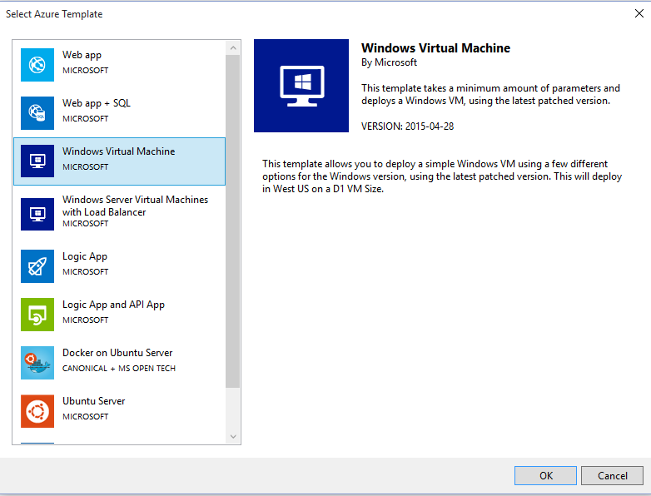
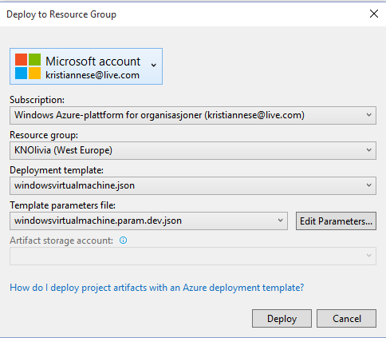
Using Visual Studio – Graphical Experience

Slide 20
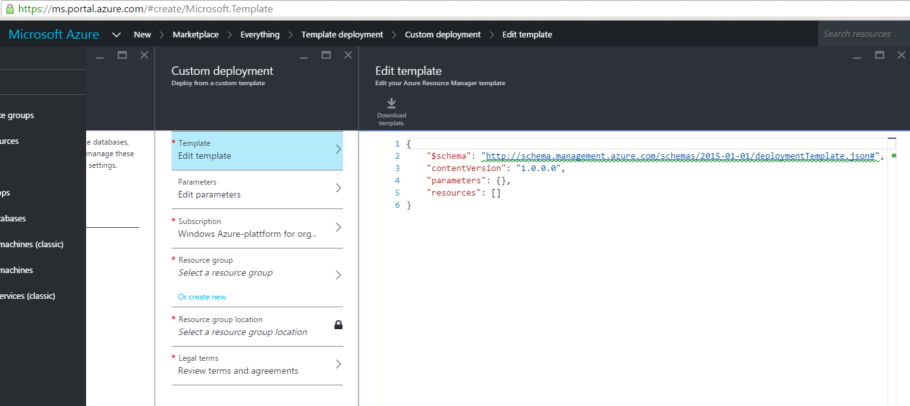
Using Portal
Notes:
Note that to get the full authoring experience in Visual Studio, the Azure SDK needs to be installed. Also, the user need access to an Azure subscription if they want to provision directly to a new or an existing resource group in Azure

Slide 21
Using Visual Studio
{
"$schema": "http://schema.management.azure.com/schemas/2015-01-01/deploymentTemplate.json",
"contentVersion": "<version-number-of-template>",
"parameters": { <parameter-definitions-of-template> },
"variables": { <variable-definitions-of-template> },
"resources": [ { <definition-of-resource-to-deploy> } ],
"outputs": { <output-of-template> }
}
Notes:
Note that to get the full authoring experience in Visual Studio, the Azure SDK needs to be installed. Also, the user need access to an Azure subscription if they want to provision directly to a new or an existing resource group in Azure.
Also point out (in the time of writing this) that deployment from VS doesn’t work with the current SDK (2.7) when you have installed the latest PowerShell module (AzureRM – 1.0.2).
<For your information, all the guides, demos and examples in this course is referring to the AzureRM module. >

Slide 22
Introducing JSON (from JSON.org)
JSON (JavaScript Object Notation) is a lightweight data-interchange format. It is easy for humans to read and write. It is easy for machines to parse and generate. It is based on a subset of the JavaScript Programming Language,Standard ECMA-262 3rd Edition - December 1999.
JSON is a text format that is completely language independent but uses conventions that are familiar to programmers of the C-family of languages, including C, C++, C#, Java, JavaScript, Perl, Python, and many others. These properties make JSON an ideal data-interchange language.
Notes:
One thing to point out is that Azure Resource Manager is JSON-based compared to the Service Management API which was based on XML.
JSON – which is an industry standard and has become more and more common to use when you want to declarative describe how your cloud services should look like.

Slide 23
Template language expressions
base64encode(‘stringtoencode’)
concat(‘string’,’to’,’encode’)
copyIndex(offset)
listKeys(storageAccountResourceId, apiVersion)
padLeft(stringToPad,targetLength,paddingCharacter)
parameters(‘parameterName’)
providers(namespace, resourceType)
reference(resourceId,apiVersion)
resourceGroup()
resourceId(‘namespace/resourceType', ‘resourceName’)
subscription()
variables(‘variables’)
Notes:
Go through the different template language expressions and explain the use case for them.
The template library you have access to will cover several of these expressions, making it convenient for you to demonstrate this to the audience.
Especially important to point out the following:
Parameters(‘parameterName’)
To create reusable templates and support input parameters, we normally start the authoring of a template by adding the parameters we require, so that the user can specify this upon deployment. You can have default parameters, allowed parameters and also add metadata such as description to each parameter.
Variables(‘variables’)
For “hard-coded” values, we can use variables – which is not exposed during deployment. These are fixed variables that are often used to simplify the language you are using in a template. An example, instead of referencing a long string over and over again in a template, you can put this into a variable you rather use.
Concat(‘string’,’to’,’encode’)
Combines multiple string values and returns the resulting string value. This function can take any number of arguments.
Example:
"outputs": { "siteUri": { "type": "string", "value": "[concat('http://',reference(resourceId('Microsoft.Web/sites', parameters('siteName'))).hostNames[0])]" } }
resourceGroup()
Example:
If you want your resources within a template to be deployed in the same region as the metadata for the resource group itself, you can reference the resourcegroup().location on the resources location property, instead of specifying the region itself.
"resources": [ { "apiVersion": "2014-06-01", "type": "Microsoft.Web/sites", "name": "[parameters('siteName')]", "location": "[resourceGroup().location]", ... } ]

Slide 24
Parameters(‘parameter’)
"parameters": {
"vmname": {
"type": "string"
},
"vmSize": {
"type": "string",
"defaultValue": "Standard_A2",
"allowedValues": [
"Standard_A2",
"Standard_A5"
]
},

Slide 25
Variables(‘variable’)
"variables": {
"virtualNetworkName": "[parameters('vnetname')]",
"vnetID": "[resourceId('Microsoft.Network/virtualnetworks', variables('virtualnetworkname'))]",
"subnetname": "ccsubnet01”
}

Slide 26
concat(‘string’,’to’,’encode’)
"subnetRef": "[concat(variables('vnetID'),'/subnets/', variables('subnetname'))]

Slide 27
Advanced Template Scenarios
Resource Extensions
VM+DSC/Chef/Puppet/CustomScript/etc.
AppService + WebDeploy
SQL DB + BACPAC
Copies
Nested Templates
NewOrExisting Patterns
Notes:
Talk a bit about the more complex scenarios and how flexible the templates can be in order to meet your requirements.
One thing to point out is the usage of Resource Extension to provide service specific configuration, such as performing operations within a guest OS. This is normally handled through a VM extension, such as DSC, Chef and Puppet, or custom scripts.
Using copies, you can easily create multiple resources of the same resource type within the same template.
A use case here would be when you want to provision 10 Vms with the same configuration at once.
You can also nest your templates which will cover more in detail later.

Slide 28
Architecting Complex Applications using Templates
Master Template
Parameters
admUserName
pwd
storageAccountname
location
vNetName
addressPrefix
subnetName
subnetPrefix
AssetLocation
tshirtSize
dscFunction
Known Configuration Resources Template [Dev, Test, Prod]
Member Resources Template(s)
Shared Resource (App-Tier) Template
Member Resources Template
Widely Re-Usable Script(s)
Optional Resource Template(s)
Optional Capability Template
Optional Capability Template
Purpose Specific Script(s)
setup.sh
Notes:
ARM is very powerful and the following deck shows exactly that.
In this example, you can see that the design of these templates shows how the different “components” of the solution are divided from each other in separate templates.
The master template will gather the user inputs – and depending on those inputs – it will call the nested templates it require in order to deploy the solution.
This makes it possible for you to design best-practice templates for vNet, storage, compute etc, and also be able to use those separately – as well as in conjunction with a master template as shown here.

Slide 29
Debugging Overview
Template validation
Use tool with JSON validation (Examples: Visual Studio, Atom w/ JSONLint, or others )
Leverage Test-AzureRmResourceGroupDeployment
Resource group logging
Portal: Browse → Resource Groups → <Group> → Events
PowerShell: Get-AzureRmLog
Azure CLI: azure group log show
Azure Rest API Explorer
View individual resources as they are deployed: https://resources.azure.com
Notes:
Every now and then you will run into situations where you have to debug a template.
Although ARM is capable – and also perform a template validation before execution, there could be other aspects that leads to a failure or warning.
Be familiar with the JSON validation in Visual Studio, and also the cmdlet ‘Test-AzureRmResourceGroupDeployment’
During the session, feel free to jump in where it suits you to demonstrate capabilities described in the presentation, such as Azure REST API explorer directly from portal.azure.com

Slide 30
Demo: Authoring a reusable ARM Template
Service Admin
Notes:
During this demo, the instructor will write an example template that will deploy one or more resources into Azure.
The template will support user inputs through parameters, to demonstrate the reusability and how the template can be used across different environments.
The instructor should feel free to use their preferred JSON editor to write this template, but for consistency and Microsoft point-of-view, Portal and Visual Studio is recommended

Slide 31
Deployment
Notes:
The following section will focus on the Deployment of resources with Azure Resource Manager, covering several interfaces, such as:
PowerShell
Visual Studio
Portal
Github

Slide 32
Deployment
tracks template execution
created within a resource group
allows nested deployments
RESOU
R
CE G
R
OUP
Notes:
Talking points:
Every deployment will (by default) go into a resource group. This will either be a new resource group you create on the fly, or to an existing one.
Every time you deploy to a resource group, you will actually create an additional resource type – which is a type of “deployment”.
You can track the deployment and get detailed log information during and after the deployment
ARM allows also nested deployments, which is ideal when designing larger templates aiming for production and flexibility.

Slide 33
Template Execution
Execution engine builds a state machine
dependsOn and reference() establish dependencies
App Insights
After Website Completes
After App Service Plan Completes
Once All Complete
Web
Site
Alert Rule
Start
App Service Plan
End
Auto Scale Setting
MS Deploy PKG
Notes:
Language Processor -- The software that parses Resource Manager Templates and Parameters. The Language processor has at least the following stages:
JSON parsing
Well-formedness checking (do the top-level objects (Parameter declarations, Resource declarations) exist and are they properly formed
Expression evaluation -- turns all expressions into their final expanded form, most notably parameter evaluation. Note that some expression evaluation will have to occur during orchestration as for example when a resource consumes outputs from a previous stage of the orchestration.
Dependency Graph construction
Dependency Graph validation (cycle detection)
Dependency Graph – One of the outputs of the Language Processor, used to determine the order of execution
Orchestrator -- The software that consumes the Language Processor output (including the Dependency Graph) and emits a sequence of REST operations to Resource Providers.

Slide 34
Insider Tips: Troubleshooting Deployment
ARM is idempotent – which is helpful in itself
Send logs to OMS for centralized logging and insight
Troubleshoot deployment with PS
(Get-AzureRmResourceGroupDeploymentOperation -DeploymentName ExampleDeployment -ResourceGroupName ExampleGroup).Properties.StatusMessage

Slide 35


Extending templates with managed IaaS (Iaas+)
Declarative and imperative injection of code and configuration into VMs
Configuration (PS, DSC, Chef, …)
Management (A/V, DR, Backup, Patching …)
Security (disk encryption, WAF, …)
…
VM Code
DSC
Extension
…
Monitoring
Extension
Runtime and Extension API
VM Agent
Infrastructure
Notes:
Talking points:
Azure Resource Manager let you use several extensions, depending on the resources you want to deploy
This slide shows native Microsoft extensions as well as third-party extensions you can use in conjunction with VM (IaaS) deployments
For IaaS scenarios, this is ideal in order to interact with the guest operating system as part of the deployment process so you can in fact be able to instantiate a complex application once the deployment job has completed. Examples here are SQL Always On, Sharepoint farm and more.

Slide 36
Insider Tips: Where can we deploy our resources?
Get supported regions
PS C:\> ((Get-AzureRmResourceProvider -ProviderNamespace Microsoft.Web).ResourceTypes | Where-Object ResourceTypeName -eq sites).Locations
Get supported API versions
((Get-AzureRmResourceProvider -ProviderNamespace Microsoft.Web).ResourceTypes | Where-Object ResourceTypeName -eq sites).ApiVersions
Notes:
Heads up!
Not all regions are supported – depending on the resource you want to provide. Use the following cmdlets in order to verify region support – as well as detecting which API version to use for that specific resoruce.

Slide 37
Demo: Deployment with ARM
Service Admin
Notes:
During this demo, the instructor will show different ways to deploy resources to Azure using either the portal, PowerShell, CLI, Visual Studio or GitHub. Ideally, the instructor will show several examples and explain what’s going on under the hood and how we are actually interacting with the ARM API and the underlying RPs.

Slide 38
Control
Notes:
Already in the template, you are able to leverage RBAC and Tags to get a better control over your long-term resources in Azure.
But also post deployment, you can manage this entirely on the resource group level and also at the resource level.
This section will introduce you to the capabilities we have with Tags and RBAC

Slide 39
Resource Tags
x
Name-value pairs assigned to resources or resource groups
Subscription-wide taxonomy
Each resource can have up to 15 tags
Notes:
Resource Manager enables you to logically organize resources by applying tags.
The tags consist of key/value pairs that identify resources with properties that you define. To mark resources as belonging to the same category, apply the same tag to those resources.
When you view resources with a particular tag, you see resources from all of your resource groups. You are not limited to only resources in the same resource group which enables you to organize your resources in a way that is independent of the deployment relationships. Tags can be particularly helpful when you need to organize resources for billing or management.
Each tag you add to a resource or resource group is automatically added to the subscription-wide taxonomy. You can also prepopulate the taxonomy for your subscription with tag names and values you'd like to use as resources are tagged in the future.
Each resource or resource group can have a maximum of 15 tags. The tag name is limited to 512 characters, and the tag value is limited to 256 characters.

Slide 40
Tagging Tips
x
Tag by environment, e.g. dev/test/prod
Tag by role, e.g. web/cache/db
Tag by department, e.g. finance/retail/legal
Tag by responsible party, e.g. Bob
Notes:
Talk about the examples shown in the presentation and how this can be used in a hosting service provider setup.
Also, give recommendations and examples from real life where this has been helpful.

Slide 41
Control with Azure Resource Manager
Role based access control
Audit logs
Resource locks
Policy
Key vault
Notes:
Azure Resource Manager let you manage and control the resources – and also the access to those resources using several different mechanisms, such as RBAC, Audit logs and resource locks.
Azure Roles-Based Access Control (RBAC) enables fine-grained access management for Azure. Using RBAC, you can segregate duties within your different teams and grant only the amount of access to users that they need to perform their jobs
Audit logs, can easily be retrieved using Get-AzureRmLog -ResourceGroup NameofResourceGroup
As an administrator, there are scenarios where you will want to place a lock on a subscription, resource group or resource to prevent other users in your organization from committing write actions or accidentally deleting a critical resource.

Slide 42
Role Based Access Control
Allows secure access with granular permissions
Assignable to users, groups, or service principals
Built-in roles make it easy to get started
Notes:
Please note: Classic subscription admins and co-admins are in effect owners of the subscription in the new RBAC model.
Azure Roles-Based Access Control (RBAC) enables fine-grained access management for Azure. Using RBAC, you can segregate duties within your devops team and grant only the amount of access to users that they need to perform their jobs
Each Azure subscription is homed to an Azure Active Directory. Only users, groups, and applications from that directory can be granted access to manage resources in the Azure subscription, using Azure Management Portal, Azure Command-Line tools and Azure Management APIs.
Access is granted by assigning the appropriate RBAC role to users, groups, and applications, at the right scope.
To grant access to the entire subscription, assign a role at the subscription scope.
To grant access to a specific resource group within a subscription, assign a role at the resource group scope.
You may assign roles at specific resources too, like websites, virtual machines and subnets, to grant access only to a resource.

Slide 43
Role Based Access Control
Notes:
Each subscription in Azure belongs to one and only one directory
Each resource group belongs to one and only one subscription
And each resource belongs to one and only one resource group.
Access that you grant at parent scopes is inherited at child scopes.
If you grant reader role to an Azure AD group at the subscription scope, the members of that group will be able to view every resource groups and every resource in the subscription.
If you grant the contributor role to an application at the resource group scope, it will be able to manage resources of all types in that resource group but not other resource groups in the subscription.

Slide 44
Granular Scopes
/subscriptions/{id}/resourceGroups/{name}/providers/…/sites/{site}
subscription level – grants permissions to all resources in the sub
resource group level – grants permissions to all resources in the group
resource level – grants permissions to the specific resource
Notes:
Here’s another view on the granularity in the context of the namespaces for subscriptions, resource group and the resource itself – which in this case is a web site.

Slide 45
Policy
{ "if" : {
"not" : {
"field" : "location",
"in" : ["northeurope" , "westeurope"] }
},
"then" : {
"effect" : "deny"
}
}
Notes:
Azure Resource Manager now allows you to control access through custom policies. With policies, you can prevent users in your organization from breaking conventions that are needed to manage your organization's resources.
You create policy definitions that describe the actions or resources that are specifically denied. You assign those policy definitions at the desired scope, such as the subscription, resource group, or an individual resource.
RBAC focuses on the actions a user can perform at different scopes. For example, a particular user is added to the contributor role for a resource group at the desired scope, so the user can make changes to that resource group.
Policy focuses on resource actions at various scopes. For example, through policies, you can control the types of resources that can be provisioned or restrict the locations in which the resources can be provisioned.

Slide 46
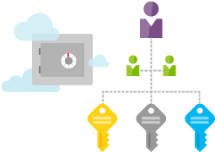
Key management with Key Vault
Encrypt keys and small secrets like passwords
Import or generate your keys in HSMs
(certified to FIPS 140-2 level 2 standards)
Grant permission for your own and third party applications to use as needed
Monitor and audit key use with Azure logging
Pipe logs into HDInsight or your SIEM for additional analysis and threat detection (coming soon)
Provision new vaults or keys in minutes
Scales to meet peak demand w/o having to deploy dedicated HSMs
Provision vaults across Azure global DCs for global redundancy
Microsoft does not see or extract your keys
Notes:
Azure Key Vault helps safeguard cryptographic keys and secrets used by cloud applications and services.
By using Key Vault, you can encrypt keys and secrets (such as authentication keys, storage account keys, data encryption keys, .PFX files, and passwords) by using keys that are protected by hardware security modules (HSMs).
For added assurance, you can import or generate keys in HSMs (keys never leave the HSM boundary). The HSMs are FIPS 140-2 Level 2 validated.
Key Vault streamlines the key management process and enables you to maintain control of keys that access and encrypt your data.
Developers can create keys for development and testing in minutes, and then seamlessly migrate them to production keys. Security administrators can grant (and revoke) permission to keys, as needed.

Slide 47
Demo: Managing resources with RBAC and TAGs
Service Admin
Notes:
During this demo, you should logon to the portal (portal.azure.com) and assign permissions to the resource group you created earlier, and use one of the tenant accounts you created in the Active Directory technical foundation module.
Also specify a tag and retrieve the information using PowerShell:
(Get-AzureRmResourceGroup –Name “name of your Resource Group”).Tags

Slide 48
Lab: Microsoft Azure Portal Template authoring Deployment (basic + advanced)
Service Admin

